Slide 1

Student Performance Prediction System
Presented By:
2520030563 - B. Siri Manasa
2520030046 - G. Pavani
Team Number: 18 | Section: 1
Under the Guidance of: Dr. Raghavendra, Department of Computer Science and Engineering

Slide 2
Introduction & Domain Background
Domain: Machine Learning and Educational Data Analytics.
- Uses student-related data to analyze academic performance.- Applies machine learning techniques to predict student performance.- Uses data visualization to identify patterns in student academic records.
Relevance: - Helps understand student academic performance using data-driven analysis.- Examines factors such as attendance and study hours in relation to CGPA.- Supports early identification of students who may need academic assistance.- Provides visual insights to support educational decision-making.
Project Context:
- The project is titled *Student Performance Prediction System*.- Uses a student performance dataset for analysis and prediction.- Includes Exploratory Data Analysis (EDA) charts to visualize academic trends.- Uses a trained machine learning model to generate performance predictions.- Provides a web interface built with React.js and a FastAPI backend.- Uses SQLite to store prediction history.

Slide 3
Problem Statement & Motivation
Problem Statement:
- Analyzing student academic performance manually can be time-consuming and difficult.-
Educational institutions need effective methods to understand student performance patterns.
Identifying relationships between attendance, study hours, and CGPA can help in academic analysis.-
Traditional methods may not provide quick, data-driven performance predictions.- Therefore, a machine learning-based system is needed to analyze student data, predict academic performance, and display insights through visualizations.

Slide 4
Literature Survey
S.No. | Author and Year | Title/Technique Used | Dataset/Tools | Key Findings | Limitation/Gap
1 | Cortez and Silva (2008) | Predicting secondary school student performance using data mining | Portuguese student records; data-mining techniques | Examined academic, demographic, social, and school-related factors associated with student grades | Focuses on secondary-school students and does not provide the integrated web dashboard used in our project
2 | Dabhade et al. (2021) | Educational data mining for student performance prediction | Institutional student data; Python and ML algorithms | Compared regression techniques to predict academic performance using student attributes and previous GPA | Study used data from a specific institution, so findings may not generalize to all datasets
3 | Garcia et al.(2024) | XGBoost implementation for academic performance classification | UCI Student Repository, XGBoost | 91.2% precision in predicting final performance grades | High computational complexity without dimensionality reduction
4 | Yağcı (2022 | Predicting academic performance using ML algorithms | Grades of 1,854 university students; multiple classification algorithms | Compared several algorithms and reported classification accuracy of 70–75% for the studied dataset | Used a limited set of academic and institutional features

Slide 5
Research Gap Identified
GAP 1 – Data-Level:* Existing approaches may not consider multiple student-related factors, such as attendance, study hours, and academic performance, together.
GAP 2 – Analysis-Level:* There is a need to combine ML-based student performance prediction with Exploratory Data Analysis (EDA) to identify academic patterns and trends.
GAP 3 – Deployment-Level:* Some prediction approaches lack an integrated, user-friendly web dashboard for displaying predictions, visualizations, and previous results.
*Our Project Addresses:* Our project integrates a trained Machine Learning model, EDA visualizations, and an interactive React.js dashboard with a FastAPI backend and SQLite database to provide student performance predictions and maintain prediction history.

Slide 6
Objectives of the Project
To develop a machine learning-based system for predicting student academic performance.
To analyze student data and identify patterns using Exploratory Data Analysis (EDA).
To study the relationship between attendance, study hours, and CGPA.
To provide performance predictions through a user-friendly web application.
To visualize academic trends using interactive charts and graphs.
To store and maintain prediction records using an SQLite database.
To support data-driven decisions and help identify students who may need academic assistance.

Slide 7
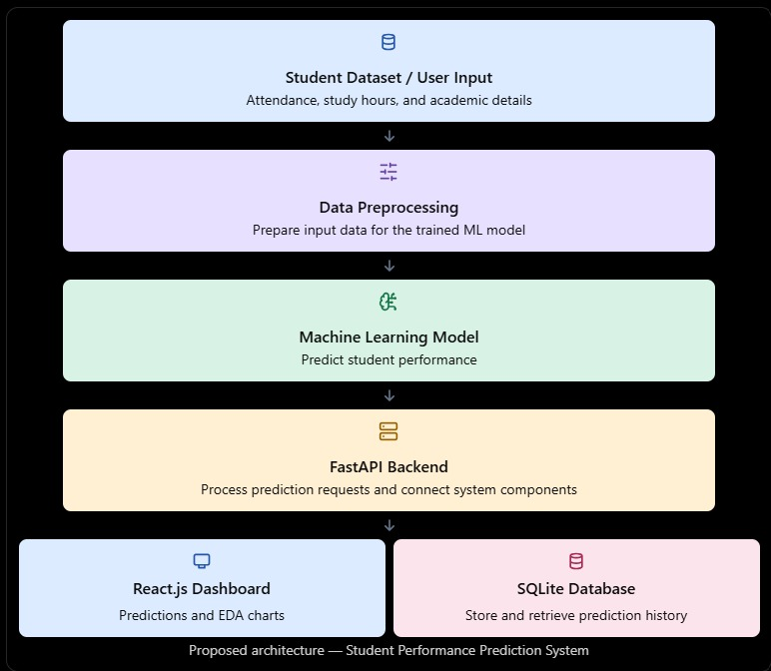
Proposed System Architecture

Slide 8
Methodology & Modules
Module 1 - Data Collection: - Gather student academic data from the dataset.- Identify relevant features for performance prediction.- Organize data for analysis and model training.
Module 2 - Preprocessing:- Clean and prepare the dataset.- Handle missing values and encode categorical features.- Transform inputs to match the trained model's requirements.
Module 3 - Core Logic- Use the trained ML model to predict student performance.- Analyze academic patterns through EDA charts.- Process predictions using FastAPI and store records in SQLite.
Module 4 - Interface- Build an interactive dashboard using React.js.- Accept student details and display prediction results.- Visualize academic trends and provide prediction history.

Slide 9
Tools and Technologies
Language: Python
Libraries: Pandas, NumPy, Scikit-learn, Joblib
3. Front End / Dashboard*- React.js, HTML, CSS, JavaScript- FastAPI for backend APIs- SQLite for database management
IDE: Visual Studio Code (VS Code)
Version Control: Git and GitHub

Slide 10
Work Completed / Review Plan
*Review Plan*- Test the prediction system with different student inputs.- Verify prediction results and dashboard functionality.- Review EDA charts and stored records.- Identify improvements for future development.
Work Completed*- Collected and analyzed the student dataset.- Performed EDA and generated visualization charts.- Trained the ML model for performance prediction.- Developed a React.js dashboard with FastAPI backend.- Integrated SQLite to store prediction history.

Slide 11
Expected Outcome & Conclusion
Deliverable: *Review Plan*- Test the prediction system with different student inputs.- Verify prediction results and dashboard functionality.- Review EDA charts and stored records.- Identify improvements for future development.
Measurable Target:
- Generate predictions from student inputs.- Display academic trends through charts.- Store and retrieve prediction records.- Verify system functionality through testing.
Conclusion:- Combines Machine Learning, data analysis, and web technologies.- Helps analyze student performance and identify academic patterns.- Provides predictions and visual insights through a user-friendly dashboard.

Slide 12
References
Scikit-learn Documentation – Machine Learning https://scikit-learn.org/2.
Pandas Documentation – Data Analysis https://pandas.pydata.org/docs/
FastAPI Documentation – Backend Development https://fastapi.tiangolo.com/
React Documentation – Frontend Development https://react.dev/
SQLite Documentation – Database Management https://www.sqlite.org/docs.html
6. Kaggle – Student Performance Datasets https://www.kaggle.com/datasets

Slide 13
Thank You

